Slide 1
Problem solving
Work in groups of four

Slide 2
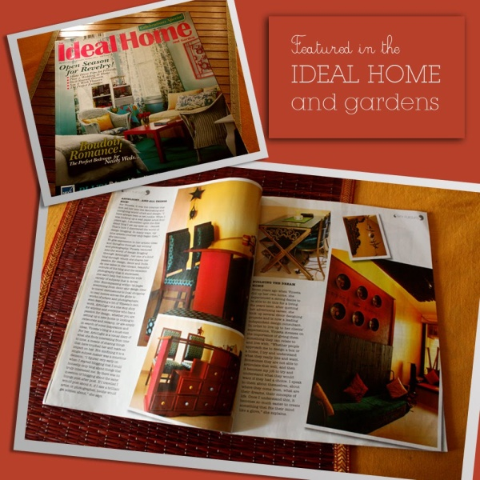
A home where the heart is
On the basis of the lesson design a dream house. Include the following points:
Location, neighbourhood, neighbours, exterior, interior, furniture and fittings, colours, etc.
Be imaginative but try to be realistic.
Draw, write and speak.

